Slide 1
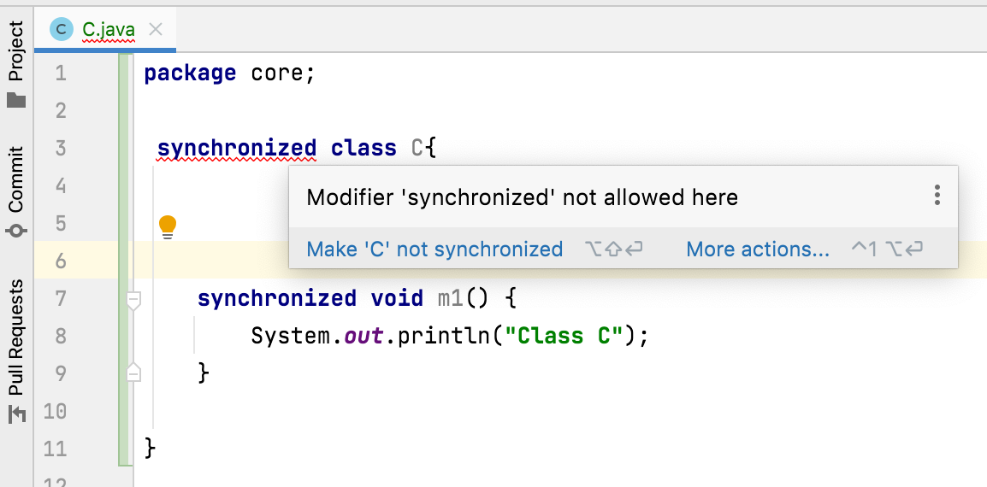
Can we declare a class with synchronized keyword?
If No, why we call classes like Vector, StringBuffer are synchronized classes?
We can’t declare a class with synchronized keyword.
If we try to declare:
Any classes which have only synchronized methods and blocks are treated as synchronized classes.
Classes like Vector, StringBuffer have only synchronized methods.

